Slide 1
DMS 201 : Introduction to Management Module-II: Financial Management Dr. Parvati Neelakantan

Slide 2
PART 1: BUSINESS ENVIRONMENT Lecture 7: Introduction to Corporate Finance

Slide 3
Topics Covered
Corporate Investment and Financing Decisions.
The Financial Goal of the Corporation.
3

Slide 4
Corporate Investment and Financing Decisions 1
Real assets.
Assets used to produce goods and services.
Financial assets.
Financial claims to the income generated by the firm’s real assets.
4

Slide 5
Corporate Investment and Financing Decisions 2
Investment decision.
Purchase of real assets.
Financing decision.
Sale of financial assets.
5

Slide 6
Table: Examples of Recent Investment and Financing Decisions by Major Public Corporations
Company | Recent Investment Decisions | Recent Financing Decisions
Intel (U.S.) | Invests $7 billion in expanding semiconductor plant in Chandler, Arizona. | Borrows $600 million from Chandler Industrial Development Authority.
Amazon (U.S.) | Acquires self-driving start-up, Zoox, for over $1.2 billion | Reinvests $33 billion that it generates from operations
Tesla (U.S.) | Announces construction of new plant to build the electric Cybertruck | Announces plans to sell $2 billion of shares
Shell (U.K./Holland) | Starts production at a deep-water development in the Gulf of Mexico | Cuts dividend to preserve cash
GlaxoSmithKline (U.K.) | Spends $6 billion on research and development for new drugs. | Raises $1 billion by an issue 8-year bonds
Ørsted (Denmark) | Completes a 230-MW wind farm in Nebraska | Arranges a borrowing facility with 14 international banks
Unilever (U.K./Holland) | Spends $8 billion on advertising and marketing | Pays a dividend and completes $200 million program to buy back shares
Carnival Corporation (U.S./U.K.) | Launches four new cruise ships | Raises $770 million by sale of bonds; each bond can be converted into about 19 shares
6

Slide 7
Investment Decisions
Capital budgeting decision.
Decision to invest in tangible or intangible assets.
Also called the investment decision.
Also called capital expenditure or CAPEX decisions.
7

Slide 8
Financing Decisions
Shareholders are equity investors.
Contribute equity financing.
Capital structure decision.
Choice between debt and equity financing.
Capital refers to firm’s sources of long-term financing.
8

Slide 9
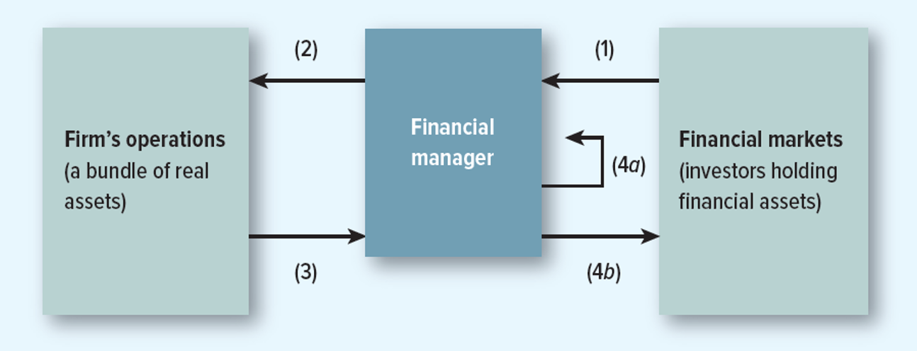
Flow of Cash Between Financial Markets and the Firm’s Operations
1) Cash raised by selling financial assets to investors.
2) Cash invested in the firm’s operations and used to purchase real assets.
3) Cash generated by the firm’s operations.
4) (a) Cash reinvested (b) Cash returned to investors.
9

Slide 10
The Financial Goal of the Corporation 1
Stockholders want three things.
To maximize current wealth.
To transform wealth into most desirable time pattern of consumption.
To manage risk characteristics of chosen consumption plan.
How can the financial manager help the shareholder?
Maximize Wealth (Fisher Separation Theorem: A financial manager’s investment decisions can be separated from shareholder preferences.)
10

Slide 11
The Financial Goal of the Corporation 2
Profit maximization.
Not a well-defined financial objective.
Which year’s profits?
Shareholders will not welcome higher short-term profits if long-term profits are damaged.
Company may increase future profits by cutting year’s dividend, investing freed-up cash in firm.
Not in shareholders’ best interest if company earns less than opportunity cost of capital.
11

Slide 12
Investment Trade-Off
The investment trade-off.
Hurdle rate/cost of capital.
Minimum acceptable rate of return on investment.
Opportunity cost of capital.
Investing in a project eliminates other opportunities to use invested cash.
12

Slide 13
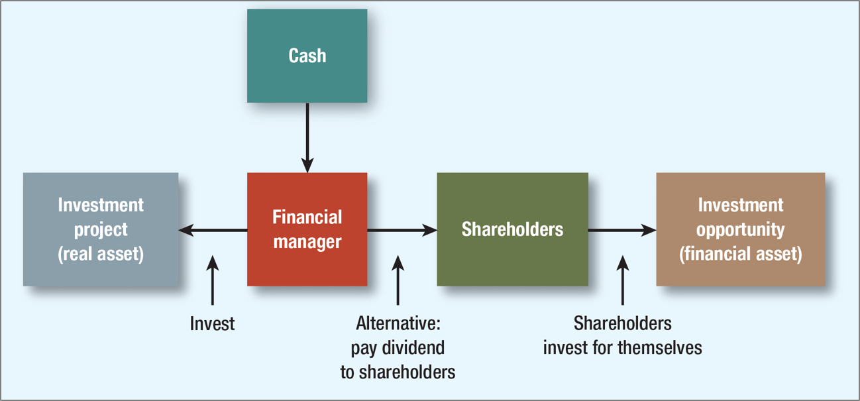
Investment Trade-Off
Arrows represent possible cash flows or transfers.
13

Slide 14
Agency Problem 1
Agency problem.
Managers are agents for stockholders and are tempted to act in their own interests rather than maximizing value.
Agency cost.
Value lost from agency problems or from the cost of mitigating agency problems.
14

Slide 15
Agency Problem 2
Do managers maximize shareholder wealth or manager wealth?
Corporate governance.
The laws, regulations, institutions, and corporate practices that protect shareholders and other investors.
15

Slide 16
Should Managers Maximize Shareholder Wealth?
Managers have many constituencies or stakeholders.
Stakeholder: Other parties affected by the company, such as customers, employees, suppliers, the environment, communities, and taxpayers.
Should managers work for shareholders or stakeholders?
16

Slide 17
Key Questions in Finance 1
How do I calculate the rate of return?
Is a higher rate of return on investment always better?
What determines value in financial markets?
What are the cash flows?
17

Slide 18
Key Questions in Finance 2
How does the financial manager judge whether cash flow forecasts are realistic?
How do we measure risk?
How does risk affect the opportunity cost of capital?
Where does financing come from?
How do companies issue new debt or equity?
18

Slide 19
Key Questions in Finance 3
How does the company’s payout policy affect shareholder wealth?
Debt or equity? Does it matter?
How do we ensure that managers act in shareholders’ interest?
Should managers maximize shareholder wealth or social value?
19

